Slide 1
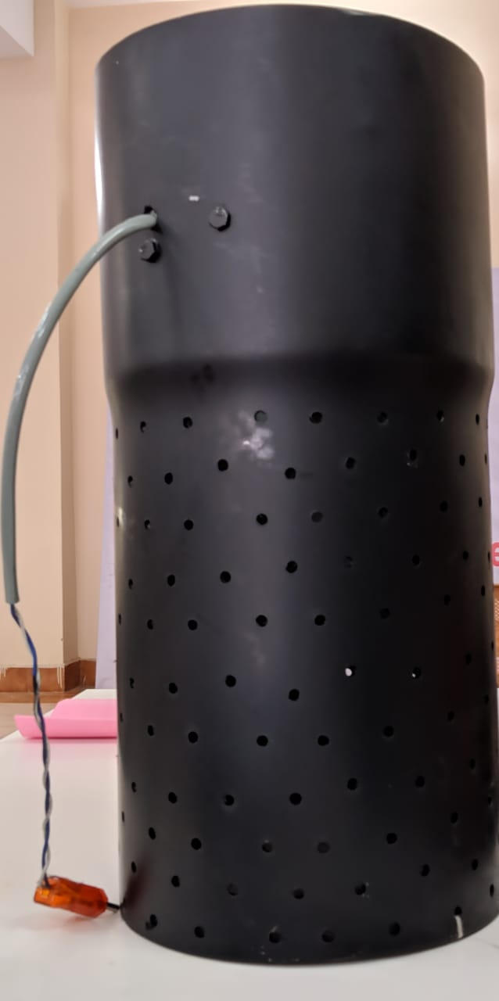
SMART AIR PURIFIER

Slide 2
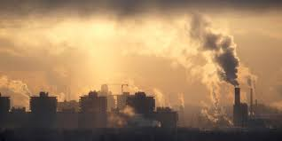
PROBLEM BEING ADDRESSED & SOLUTION
PROBLEM:
Depletion of breathable air.
SOLUTION:
A smarter approach to purify the air .

Slide 3
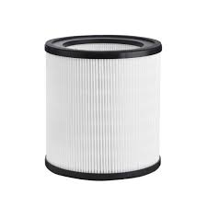
PRODUCT/SERVICE
Briefly describe the product:
Step 1:
We will initially check the pollutants level in the atmosphere .
Step 2:
If it reaches the harmful level , then the working of the purifier starts.
Step 3:
The intake of the impure air is from bottom.
Step 4:
The HEPA filter purifies the impure air and the purified air is released from the upside .

Slide 4
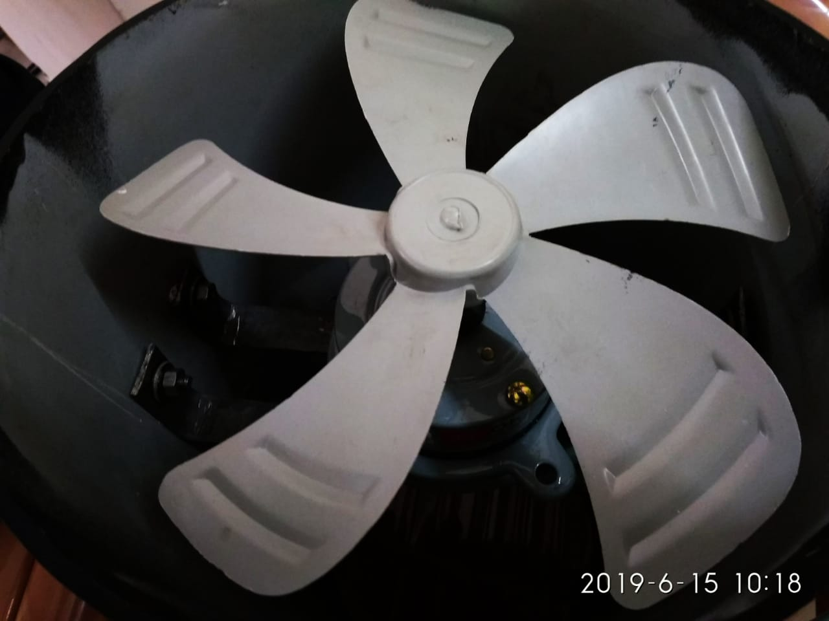
Internal structure
The Purifier internal structure has a circular structure which helps fast air inhale system from the surroundings and HEPA filter helps clean the dust, Condensed particles, Tiny particles like wood, papers, Plant fibers like cotton, pollen and human hair and animal fur. Second layer of Filter helps in filtering out PM2.5, 0.3 micro particles from the air.

Slide 5
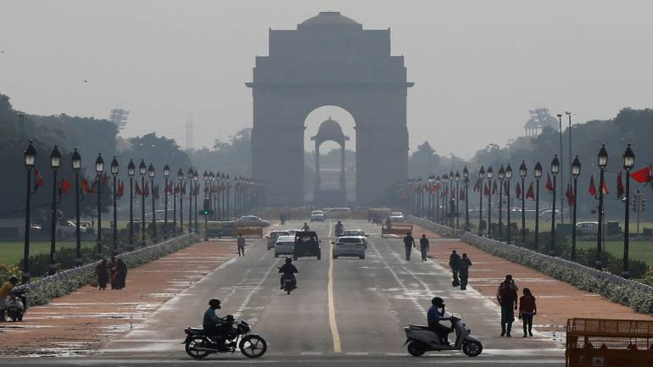
MARKET
Who are your customers:
Everyone is a customer , from an individual to an organisation.
How many prospective customers are there totally:
Cities with high air pollution like Delhi.
How many can you address now:
To cover the maximum polluted areas in a city.

Slide 6



COMPETITION
Who are your competitors:
Philips,Bluestar , Xiaomi.
How have they succeeded:
Philips:
Founded in 1891. It started with the basic electronic appliances and grew eventually and in 2014 ,the stepped into the market of air purifiers .
Bluestar:
75-year-old air conditioning brand 'Blue Star' is reinventing itself to cater to a growing consumer market
Xiaomi:
Leading electronic company in China launched several electronic products , eventually they stepped into the market of air purifiers .
How are you different than your competitors :
The existing air purifiers has the rectangular or square structure . Our product has circular structure which intakes the more amount of air unlike the competitiors present in the market . The feature that makes this product standout from the competition is mobility.

Slide 7
MARKETING STRATEGY
Where are your customers:
The potential customers are expected to be found in the cities due to risk of high air pollution .
How will you reach out to them :
we will arrange camps to educate people about the ill effects of air pollution and bring awareness about air filters
What marketing channels/methods will you use :
Now we are going to use paid promotions and Social media to advertise the product in public .

Slide 8
REVENUE MODEL
What are your revenue sources:
1)Profits will be the main revenue in case of the success of product.
2)We can expect low revenue in case of less sales but still the cost of production is very low compared to profits
Price of your product:
1) Price of the product is 5,000 rs.
2) Manufacturing cost is 4000 rs.

Slide 9
FINANCIALS
PARTICULARS | PRICE
Manufacturing cost | Rs 4000
Selling Price | Rs 5000
Profit/Unit | Rs 1000
No of units sold | 600
Total revenue | 30,00,000
Manufacturing expenses | 24,00,000
Advertising expenses | 5,00,000
Profit | 1,00,000
Breakeven Period | 11 months

Slide 10
Q&A

